Slide 1


Slide 2
OBJECTIVE
This project acts as a marketplace for sellers to showcase their products and for the buyers to validate all the products manufactured directly by the seller.
This project acts as the mediator between seller and buyer by exploiting the other mediators.
This allows all the category wise sellers to form into groups for further use of raw materials from other sellers.

Slide 3
REQUIREMENTS
PERSONAL COMPUTER / LAPTOP
APACHE (XAMPP) SERVER INSTALLATION
TEXT EDITORS(VSCODE,SUBLIMETEXT,ETC.,)
ONLINE DOMAIN FOR HOSTING (GO DADDY)

Slide 4
TECHNOLOGIES USED
FRONTEND: HTML, CSS, JAVASCRIPT, JQUERY, AJAX, BOOTSTRAP
BACKEND: PHP
DATABASE: MYSQLI

Slide 5
SOLUTION
The solution is that we planned to provide a user- friendly web application which acts as an intermediate resource between seller and buyer.
That allows sellers to upload pictures and videos of their products and the nearby courier services can also register and provide their services.
All the sellers of each city are divided into groups based on the products they make.
For each group, a team leader is being assigned who acts as a single point of contact for the seller and the team for which the problem of unemployability can be decreased.

Slide 6
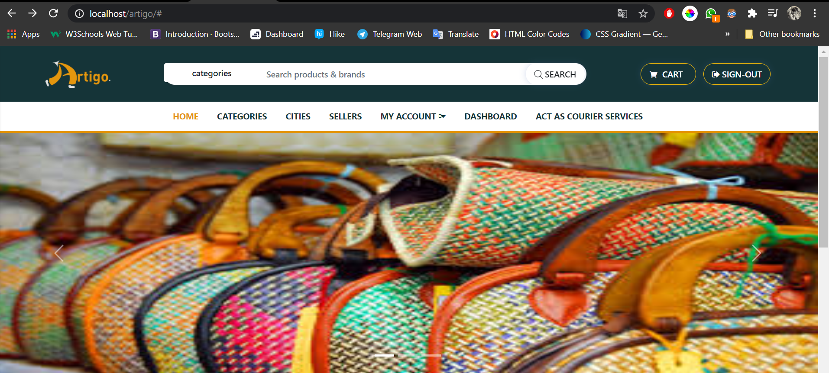
USER INTERFACE

Slide 7
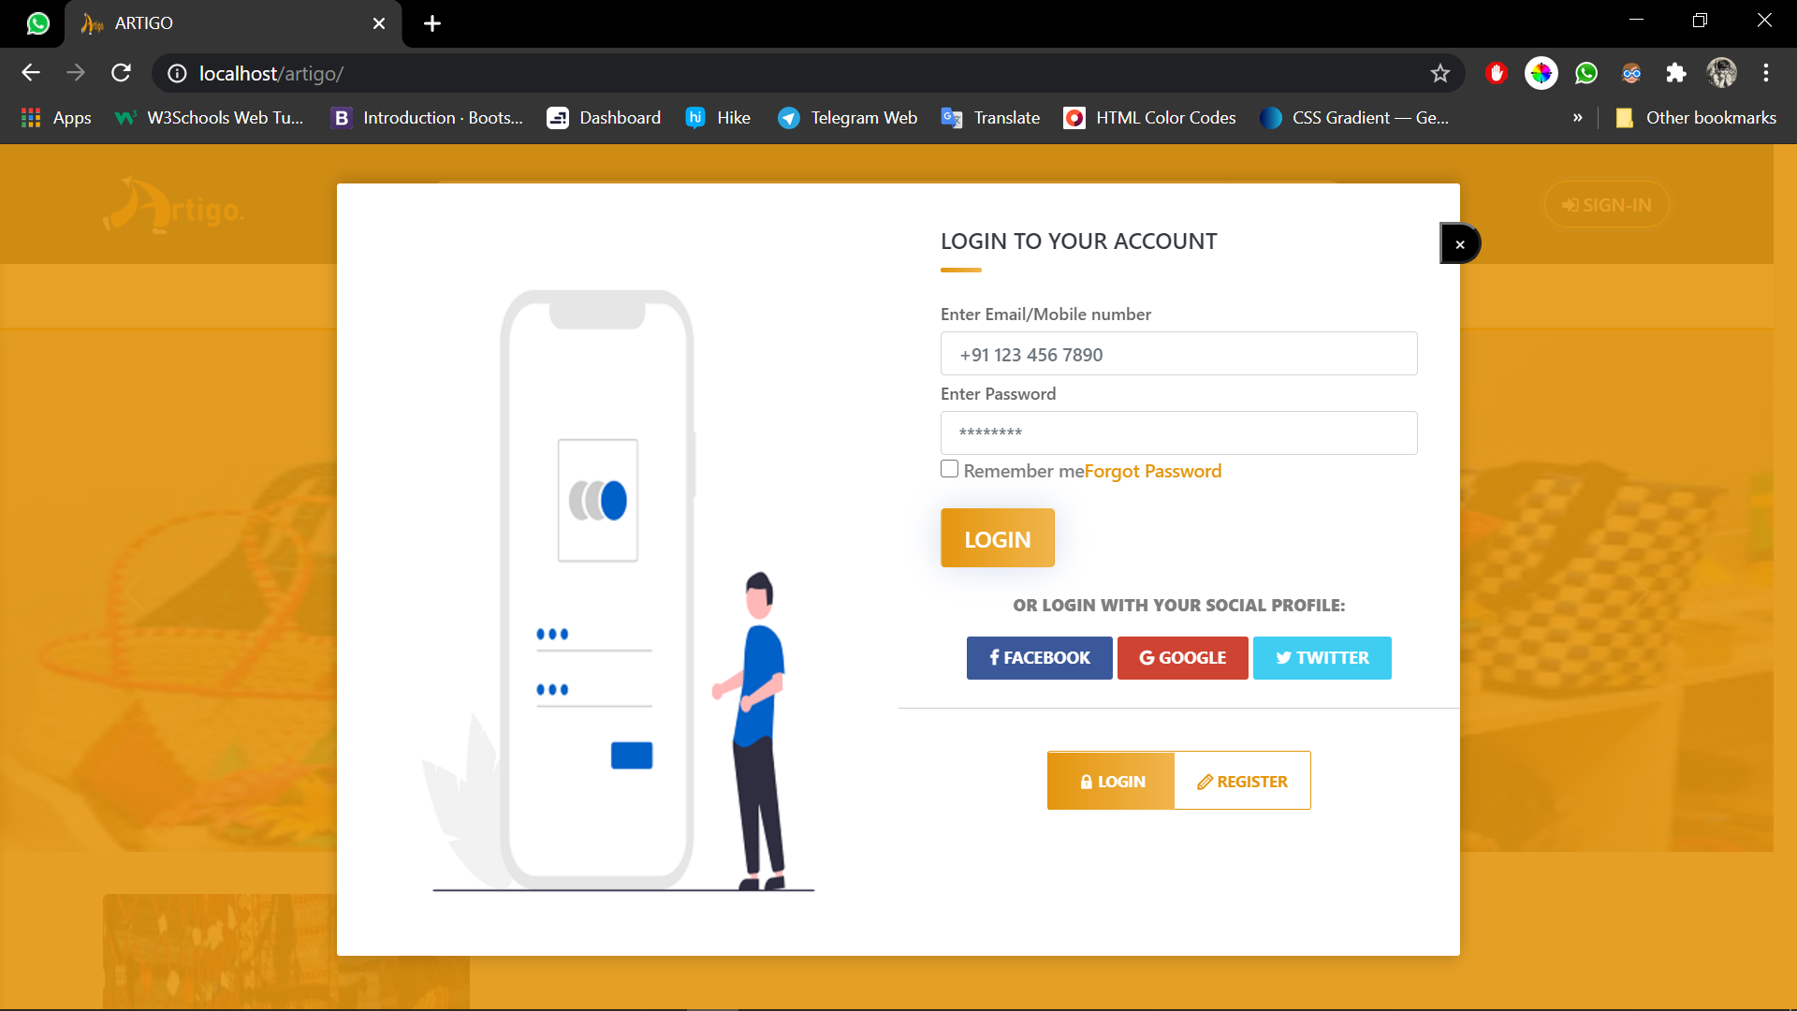

Slide 8
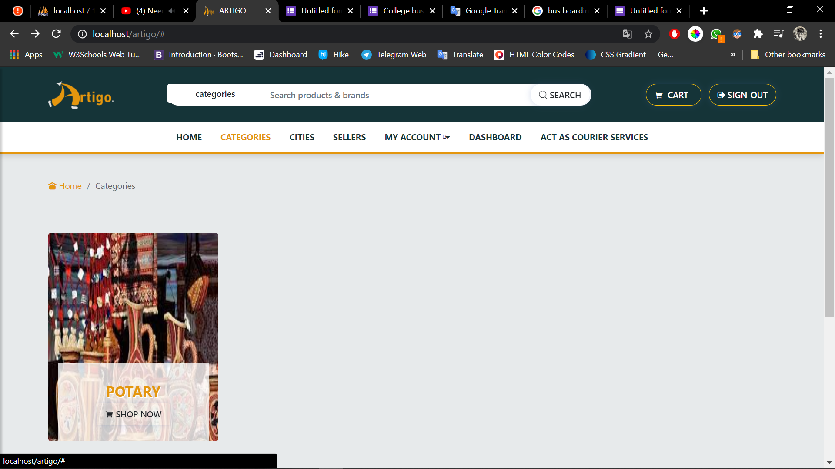

Slide 9
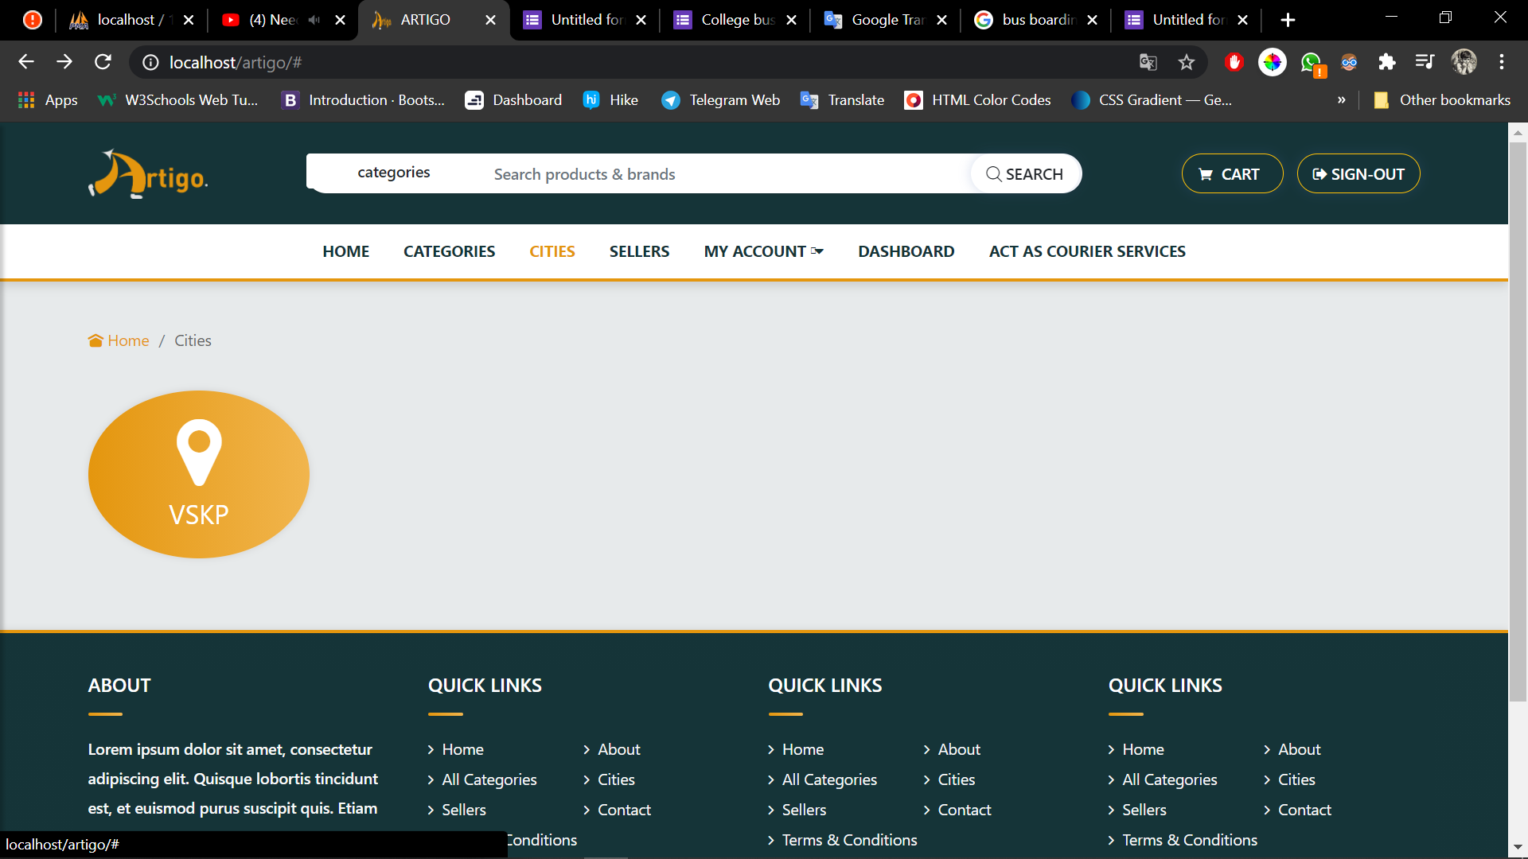

Slide 10
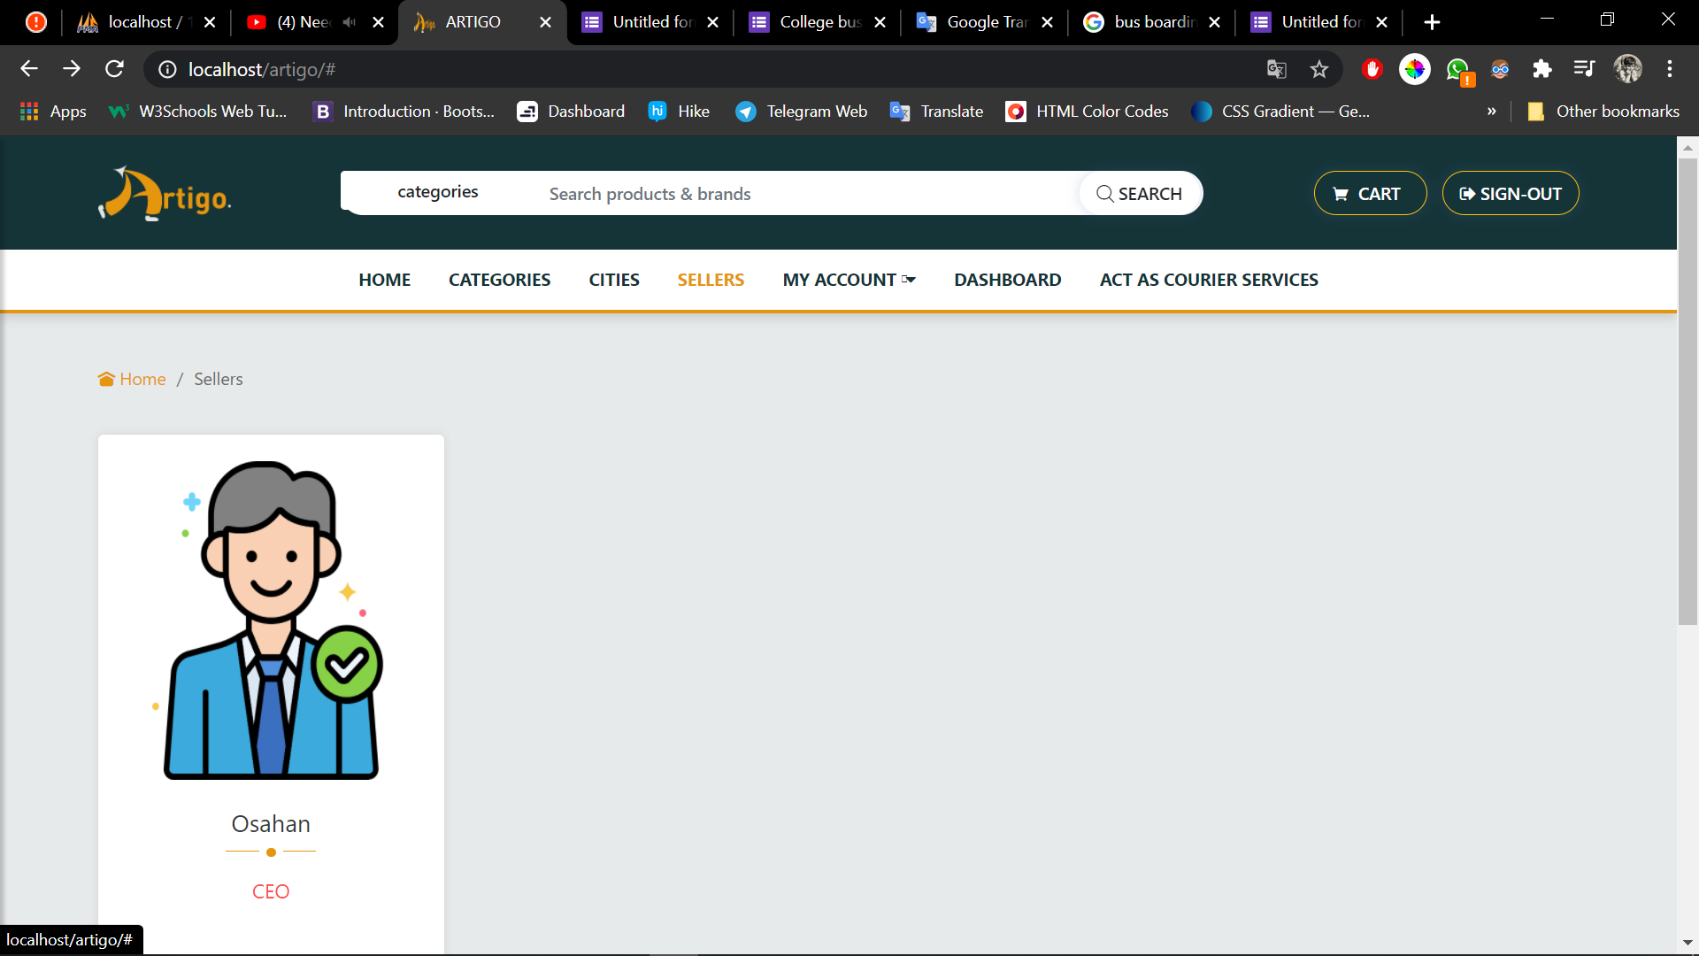

Slide 11
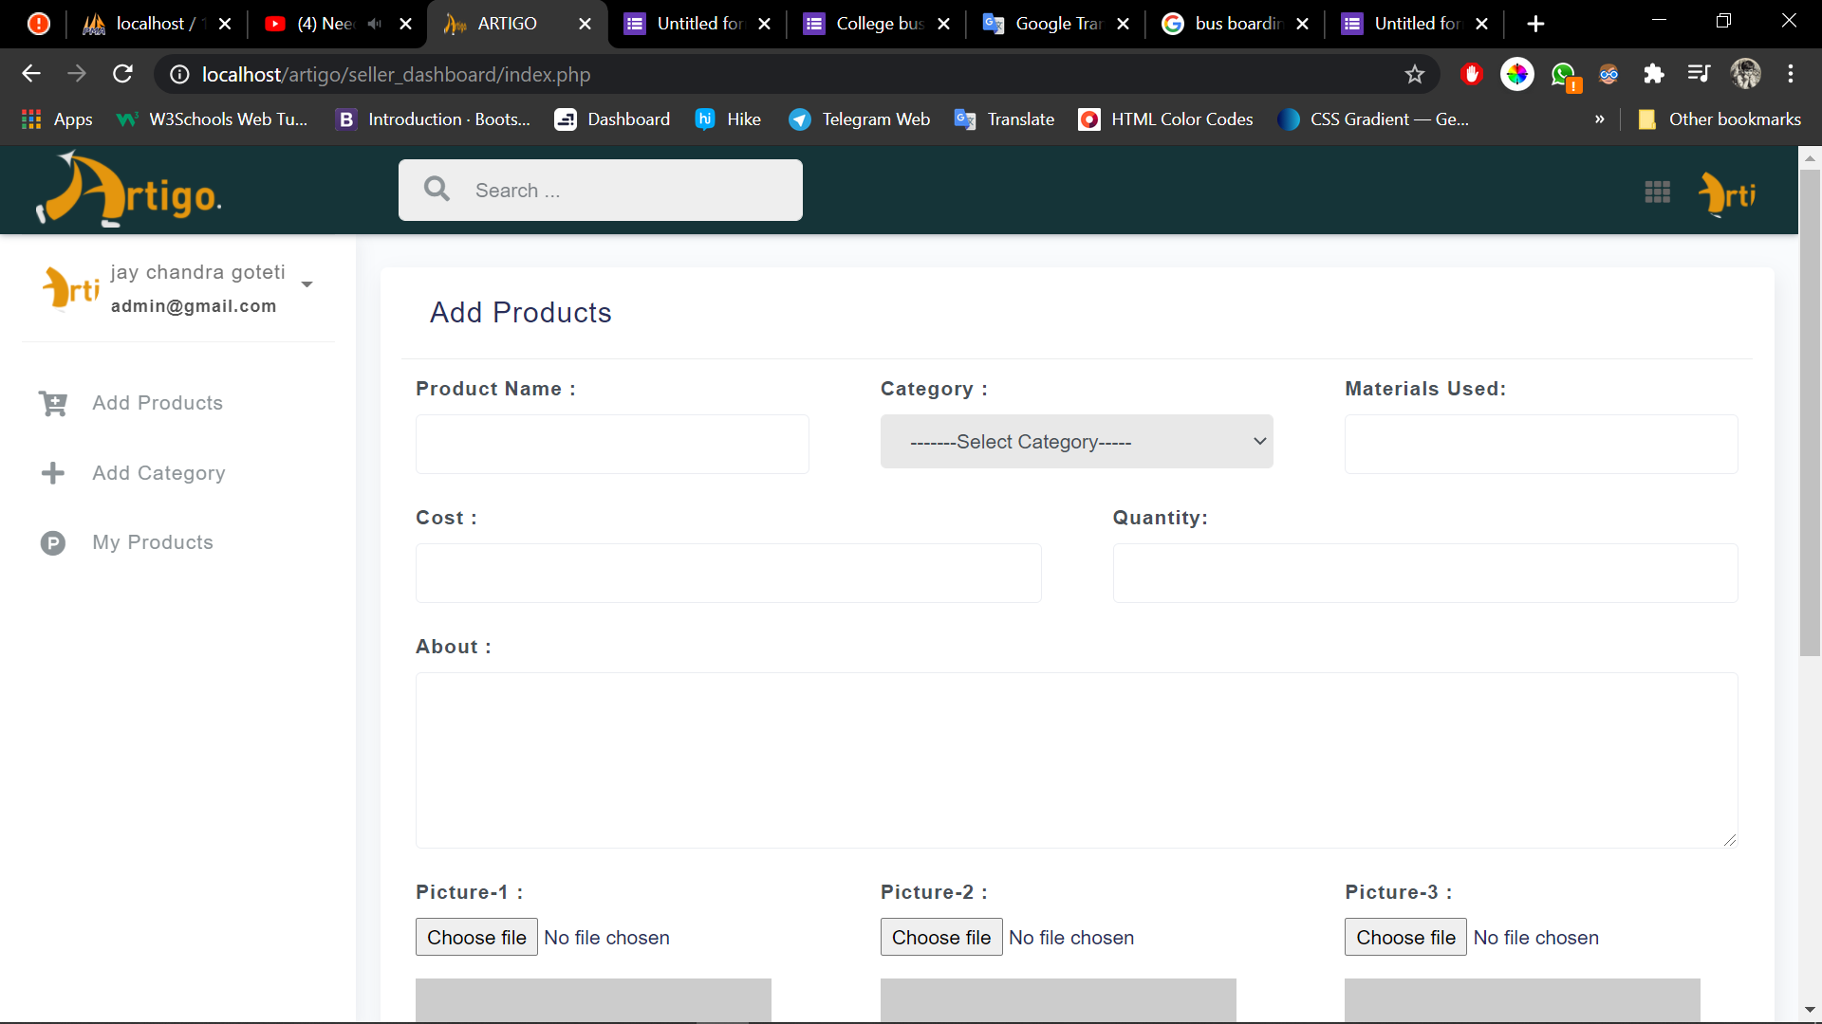

Slide 12
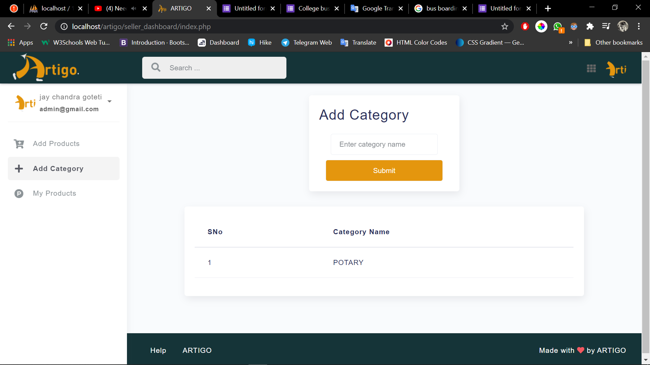

Slide 13
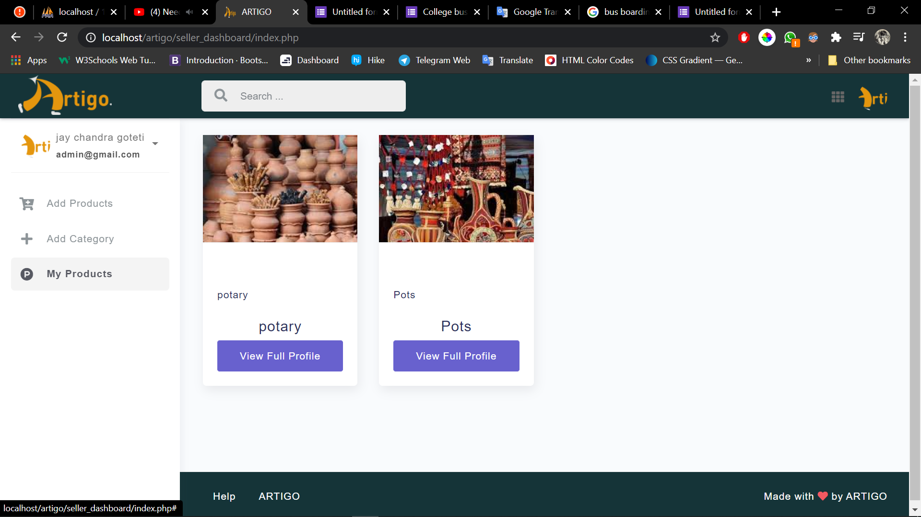

Slide 14
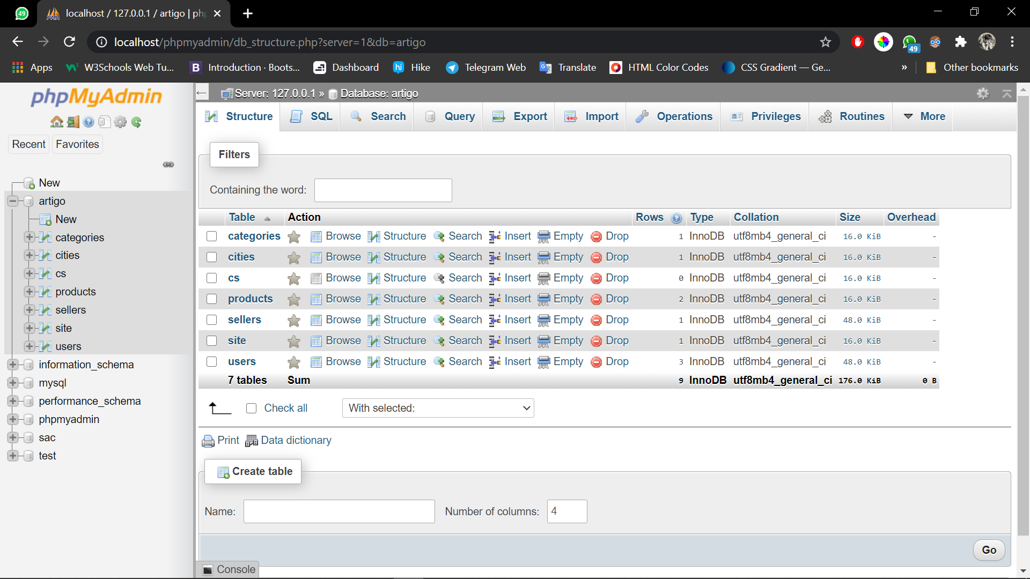
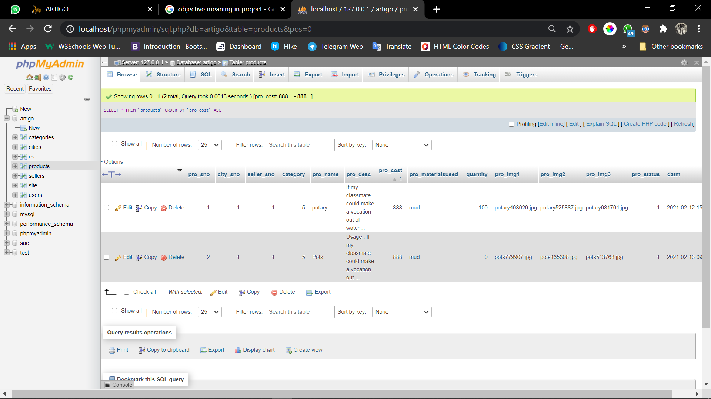
DATABASE DESIGN

Slide 15
ANY QUESTIONS ??

Slide 16
THANK YOU

